Slide 1


Slide 2
Shane Foley
Custom Application Developer (Neudesic)
Full Stack
Mobile Development
API Development
Data Architecture
Integration Testing
Cloud
ASU Graduate (2017)
School of Computing Informatics and Decision Systems Engineering
Computer Science (BS)
Notes:
Shane Foley is the presenter of “Getting Your Xamarin Projects Off The Ground.” Shane Foley is a Custom Application Developer that has been working for Neudesic for the last 4 years. Although highly experienced in Xamarin mobile application development, Shane overall is Full Stack. Shane actively works on building APIs in .NET and java environments, and is involved in data architecture associated with building APIs. Shane also works on automated integration testing, and utilizing the cloud. As for an educational background, Shane graduated from Arizona State University’s School of Computing Informatics and Decision Systems Engineering with a Computer Science Bachelor of Science.

Slide 3
What is Xamarin?
Notes:
So, the main purpose of this presentation is learning how to get Xamarin mobile projects off the ground. The first thing to always answer in a Xamarin presentation is “What Is Xamarin?”

Slide 4
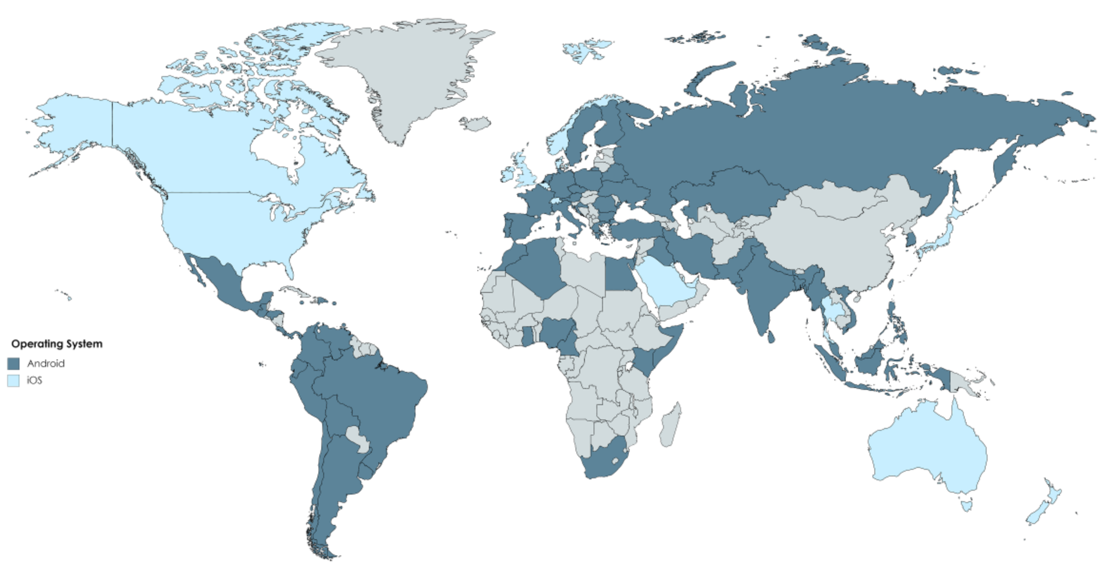
Back in The Day
You need to build a mobile app
IOS
Android
Flashback 2008
IOS Development
Objective C
Swift (2014)
Android Development
Java
Notes:
First to understand Xamarin, let’s first look at some history about mobile development. Back in July 2008, developers first started to get their bearings developing iOS mobile applications as the first development kits were release alongside the app store. The decision to develop for iOS was relatively straight forward, because that was the only platform available. Although at that time the app store was rather parse because of the newness of the technology (only 3000 as of September 2008). Developing mobile applications became a bit more difficult later in 2008 when Android first came to the scene. Now businesses were forced to make the decision if they would target iOS, Android, or both.

Slide 5


How Can We Get 2 for 1?
Notes:
As time went on, developers questioned if there was a better way to target not just one, but both with the same code base?

Slide 6
What is Xamarin?
Cross-platform UI toolkit
iOS
Android
UWP
Purchased / Supported by Microsoft
Purchased existing Xamarin project (February 2016 – $500M)
Development done using .NET
C# or F#
.NET Standard
XAML
Notes:
Xamarin is Microsoft’s cross platform UI toolkit. There are three flavors: Xamarin.Android, Xamarin.iOS, and Xamarin Forms. Generally, industry levitates towards using Xamarin Forms to get the most amount of reusable code. Xamarin initially was privately owned, but was later purchased by Microsoft February 2016 for $500M. To develop using Xamarin, you’ll be working with Microsoft’s .NET Framework. Programming languages include C# and F# (although almost always C# seen in industry). Projects are .NET Standard. UI development can be done using code, but more often is built using XAML.

Slide 7
Ok, But Why Do We Care?
Notes:
Now that we have a high level understanding of what Xamarin is, why exactly do we care? We have the ability to develop iOS and Android via methods provided by App and Google, so why should we consider using Microsoft’s solution?

Slide 8

The Benefits: Talent
Many IT professionals familiar with .NET
Can utilize existing company talent
Staffing non-existing talent easier
Staffing for .NET, not Swift/Objective C + Java
Notes:
To go into the benefits of using Xamarin, first, think about finding talent. Likely, at your company’s IT department, many of the developers are probably already familiar with .NET. So, for them, the learning curve is not as steep as it would be learning Swift/Objective C and Java. Additionally, when you are staffing a project, you have the ability to narrow your search to a single framework. Otherwise, you would have to staff for two languages, which may lead to a longer search, or multiple hires.

Slide 9

The Benefits: Time
Benefits projects with shorter timelines
Startups
Proof of Concepts
Critical Initiatives
Notes:
Also, consider the benefit of time. Many projects face time constraints where we need to deliver value quickly. First, consider the startup. A startups first couple of years are extremely critical. Whether an app is a product, or essential for daily processes, for a startup time is essential to maintain strong value delivery. Additionally, many companies just want to implement proof of concepts to show that something is possible before committing to time, personnel, and monetary resources.

Slide 10

The Benefits: Money
Development savings
Shorter development cycle
Less developers required
Less resources to maintain
Apps shipped to the app store faster
Can provide services to customers faster
Generates app sales faster
Generates ad revenue faster
Notes:
Finally, the last benefit is the bottom line; money. Money is the driving factor for businesses, and without a doubt Xamarin helps business save it and earn more of it. As mentioned countless times, we are targeting multiple platforms. By doing this we have a shorter development cycle, require less developmental talent, and require less maintenance. All of the previous correlates directly to money savings. Additionally, since we target multiple platforms, we are able to ship to the app store faster. This means that we can do the following faster: provide services to customers, generate app sales, and generate ad revenue.

Slide 11
How do I Get Started?
Notes:
Ok, so we have looked at what Xamarin is in general, and the benefits it provides, so the next question is “How do I get started?”

Slide 12
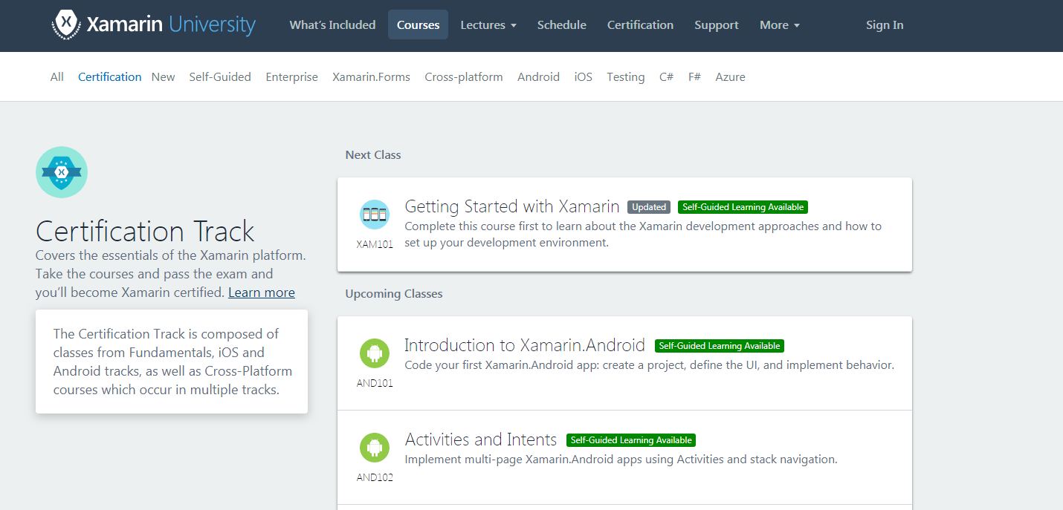
Xamarin University
Notes:
Right now, the best place to get started using Xamarin is Xamarin University. For the last couple of years, Xamarin University has been Microsoft’s go-to place to provide education to developers that want to learn Xamarin. It provides development instruction regarding Xamarin.Android, Xamarin.iOS, and Xamarin Forms. Additionally, it provides two certification tiers: professional, and developer. The first tier, professional, provides overarching fundamental background on Xamarin development. The second tier, developer, provides a deeper understanding around the Xamarin toolkit, including more complex topics such as list customization, data binding, and memory management. IMPORTANT NOTE! Xamarin University is in the process of being retired. All materials are being migrated to Microsoft Learn, and will soon be free. My suggestion is to use Xamarin University for the free courses available now while this migration happens, and then finish out the paid resources after they are made available through Microsoft Learn for free.

Slide 13
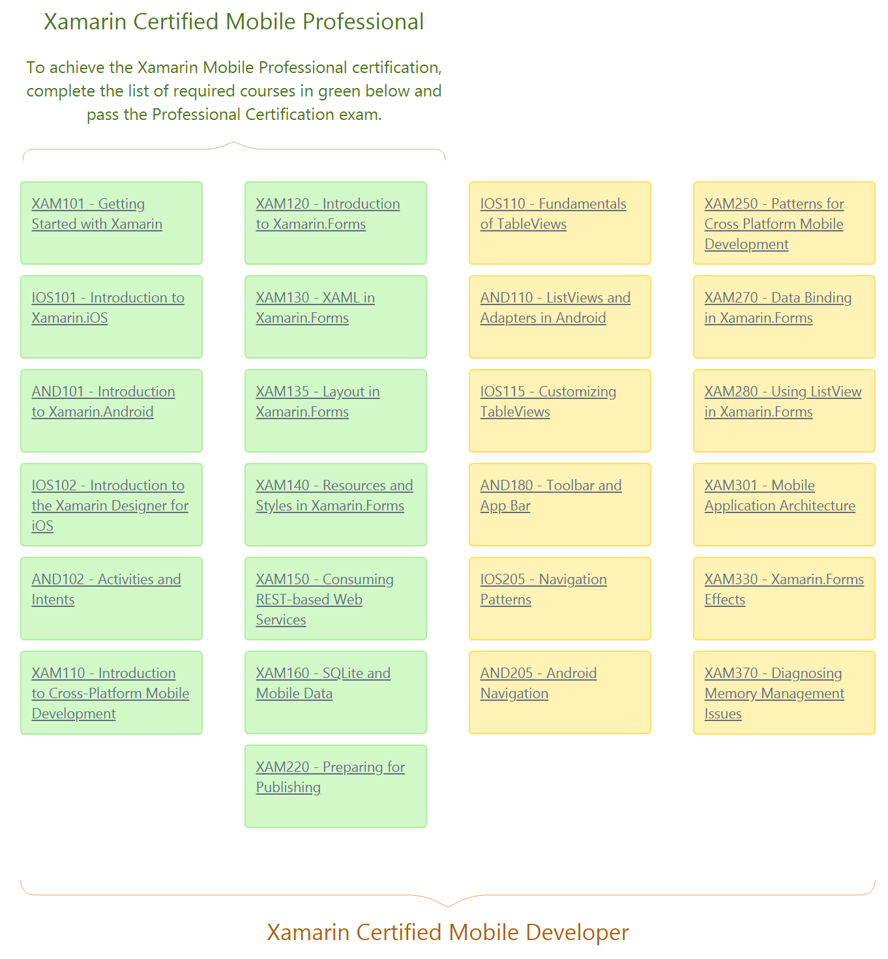
Notes:
If it is 100% critical and you need to get a development certificate now (perhaps for a project), the tracks look like this. Notice that the bulk of the courses focus on Xamarin Forms. This is because business mainly utilize Xamarin Forms.

Slide 14
Now, Getting Your App Off The Ground
Notes:
Ok, now that we know where to learn about Xamarin Forms, let’s learn how to get started with our project.

Slide 15
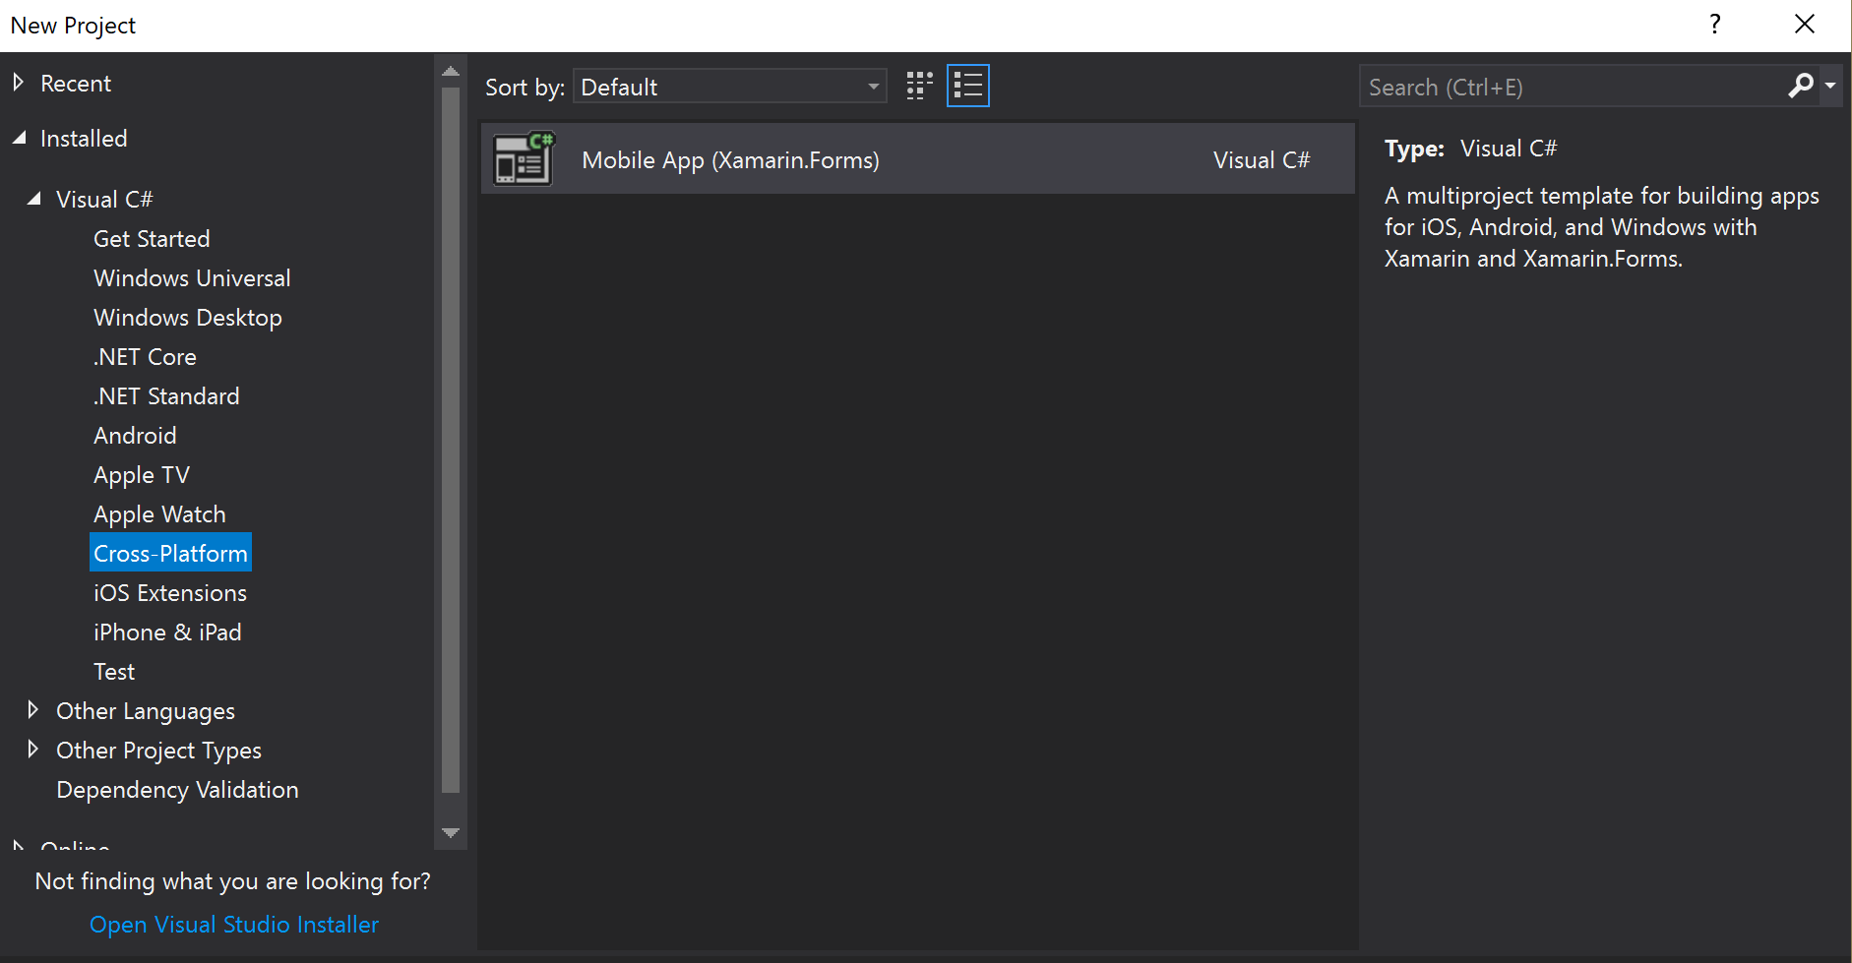
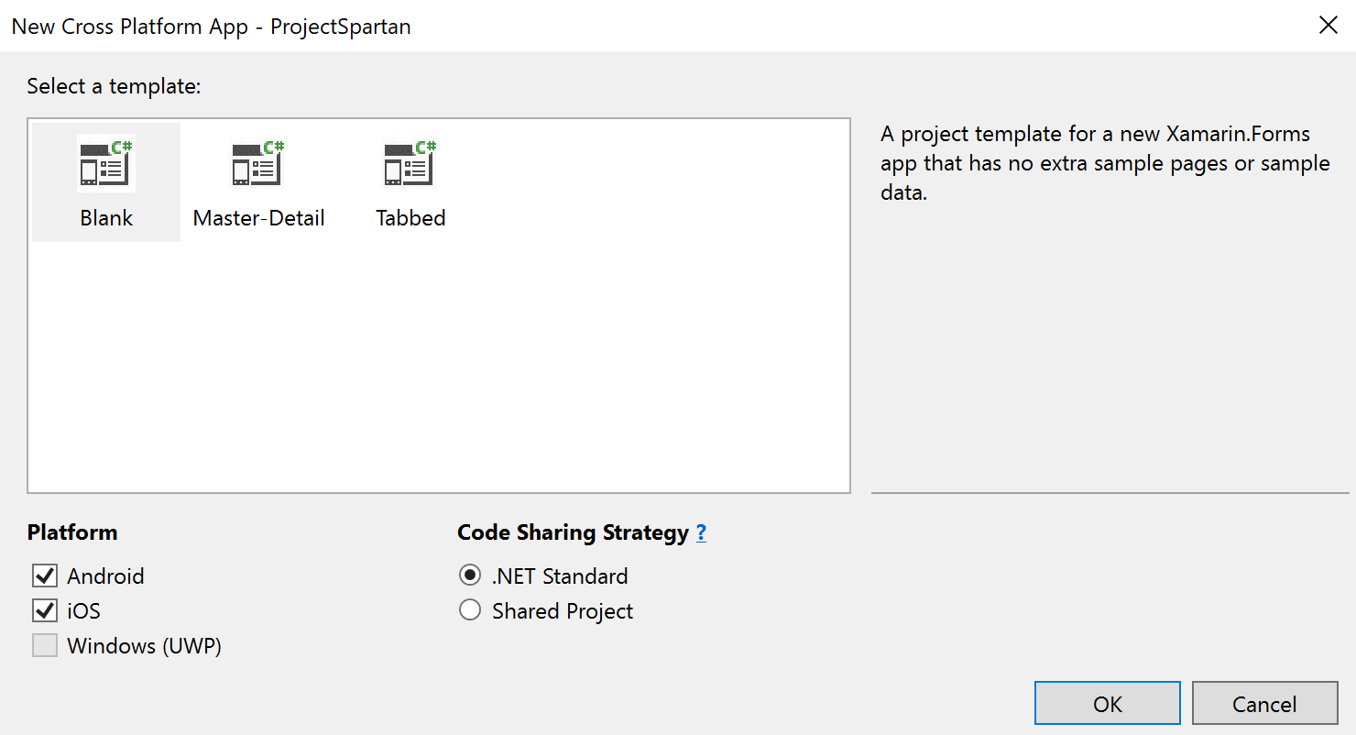
The Easy Part, Creating the Project
Notes:
First off, we will need to make a Xamarin Forms project. You will do this by selecting File → New → Project → Visual C# → Cross-Platform → Mobile App (Xamarin.Forms). Note, during this presentation, I will be focusing on Xamarin Forms since it is more widely used. Once you determine your project name, we will go ahead and select a project type. For almost all applications, you will want to choose blank. It provides a starting point with the least amount of boilerplate, which allows you the rearchitect your application structure a bit easier.

Slide 16
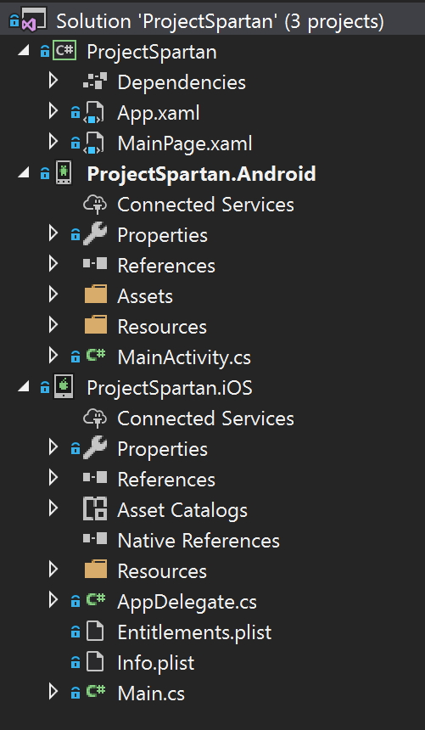
You’ll See Something Like This
Shared Code Project
Shared Code Starting Point
Android Platform Specific
Android Starting Point
iOS Platform Specific
iOS Starting Point
Notes:
Upon creation of your Xamarin solution, you will encounter multiple projects. The first project is your shared code. This is where 85% of your application’s logic will live. Additionally, you will have projects for each platform that you specify upon creation (Android, iOS, and UWP). Inside of the Android project, we have the MainActivity, where Xamarin is initialized, and directs us to the App.xaml.cs. The same thing happens in the iOS project.

Slide 17
The Dividing Lines
Experienced Xamarin Developers know what belongs in a project
Novice developers may not
Companies will often have .NET developers help with Xamarin projects
May not be familiar with mobile development
Notes:
With a little explanation, we can see the basic dividing lines in our application. This being between the shared code and the platform specific code. This may seem obvious, but for novice developers that join our teams, it is always good to spell things out so those not familiar with mobile development can understand.

Slide 18
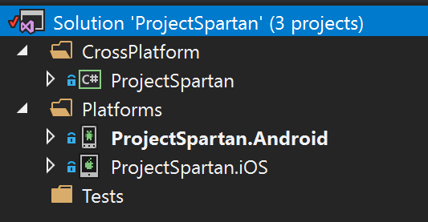
Now Reorganize
Explicitly call out application divisions
More friendly to your novice team members
Notes:
So, instead of keeping the solution directory structure the same as out-of-the-box, we are going to spell things out. First, we have a “CrossPlatform” piece of our solution, which accounts for 85% of our code. Then we have our platforms, which accounts for the remaining 15% of code. Furthermore, we have our tests. Note, for a Xamarin Forms solution, you will be mainly concerned with providing code coverage for your CrossPlatform projects. This is because your platform specific code will be mainly for resolving platform dependency and providing renderers, both which are not easily unit tested (this being without automated testing in consideration).

Slide 19
Breaking Up The Party
Now we have a single project for all cross platform code
Need to break this apart
How?
Notes:
Now, we have our platforms and cross platform projects divided, but something seems… off. Now we have a single project to cover 85% of code. For our solution to make more sense, we are going to want to break this project apart into projects with specific duties to fulfill.

Slide 20
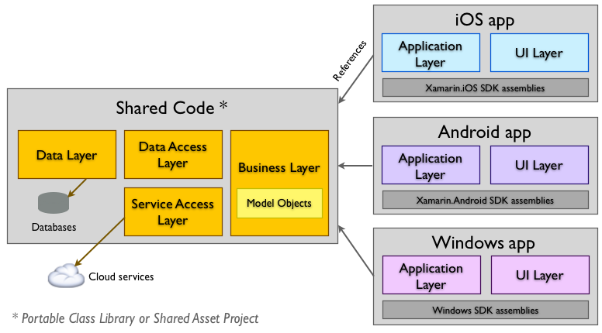
Microsoft’s Suggested Architecture
Notes:
Now, lets take a look at Microsoft’s suggested architecture. First, consider the data layer for the mobile device. Overall, here, we are looking at accessing local storage in relation to SQLite databases, files, photos, etc. For a mobile application, you can easily segregate local storage related code into it’s own project, and you should. Now, consider the service access layer. This is where all of our applications network related code is housed. Generally, we are looking at repositories here, as they are related to GET, POST, PUT, DELETE operations (essentially CRUD). Next, consider the business layer of an application. We see that the business layer is closely related to our model objects. Overall, for our business code, we are utilizing data access and service layers to perform calculator and constructive operations to build up our applications data structures. This is where we piece everything together to provide value to the end user.

Slide 21
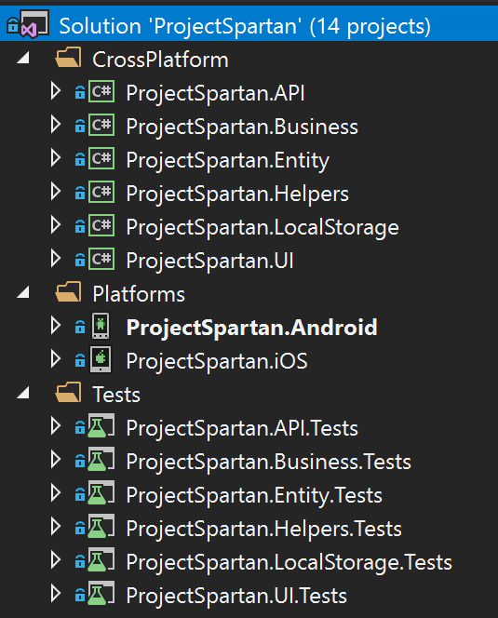
Add Additional Projects To Delineate Responsibility
Notes:
Upon breaking apart, we land on a project hierarchy similar to the following.

Slide 22
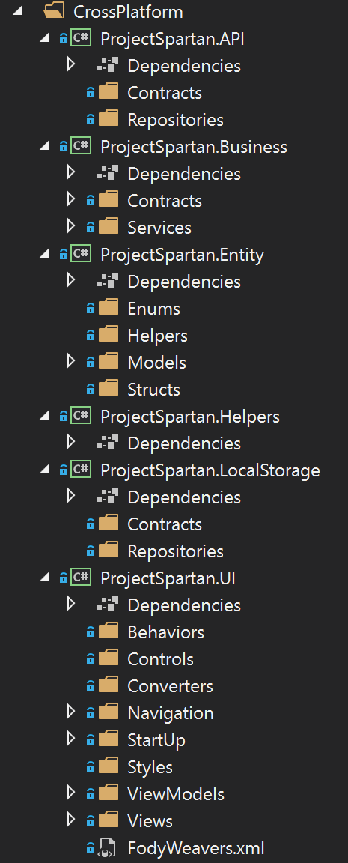
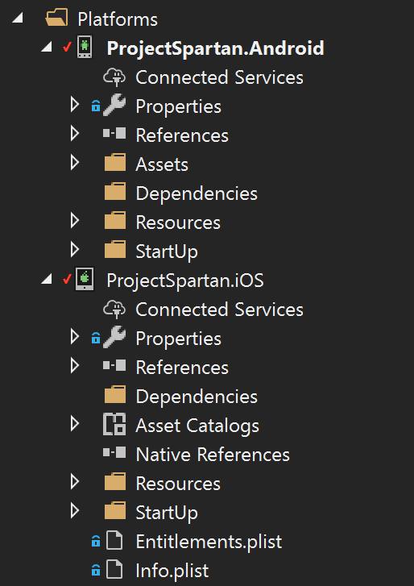
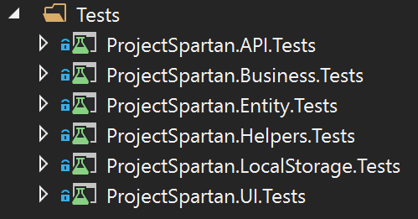
Add Additional Projects To Delineate Responsibility
Notes:
Now, let’s go a little bit further and break apart each of the individual projects. First, consider the API project, which has the purpose of communicating to outside APIs. First we have our contracts, which will be interfaces for API communication. Then, we have our repositories, which is interface implementations to communicate with APIs. Note, these are repositories, not services. It is common to see this mislabeled throughout the field, but by definition, a service does not have insight about data retrieval, but instead makes decisions and manipulates data structures based on data retrieved by outside processes. Next we have our Business project. Again, we have contracts……

Slide 23

Resolving Common Platform Dependency
Notes:
Now, consider most of the information the is important to mobile devices. Device information for error reporting, network communication status, geolocation, map integration, etc. The list goes on and on. For an application to be viable, it needs to gather information with implementation that are specific to iOS and Android.

Slide 24
The Long Way (Dependency Service)
Notes:
Ok, now that we know where to learn about Xamarin Forms, let’s learn how to get started with our project.

Slide 25
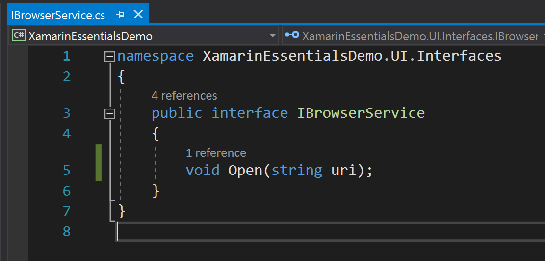
Steps To Building Cross-Platform APIs With Dependency Service: Define Interface
Notes:
First, you will want to define and interface for your API in your project with your shared code.

Slide 26
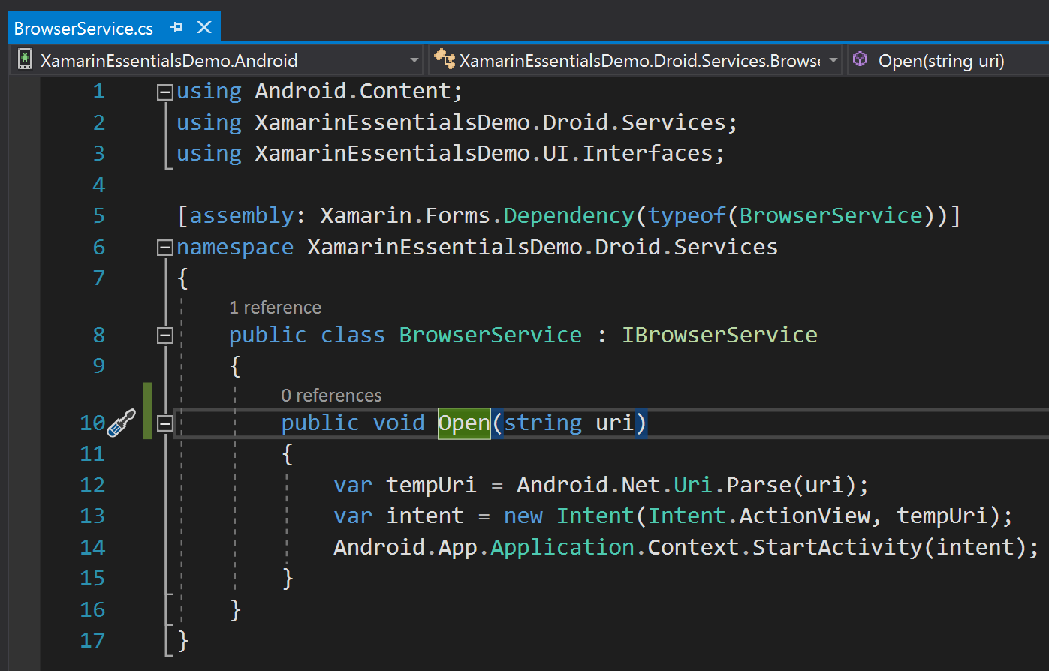
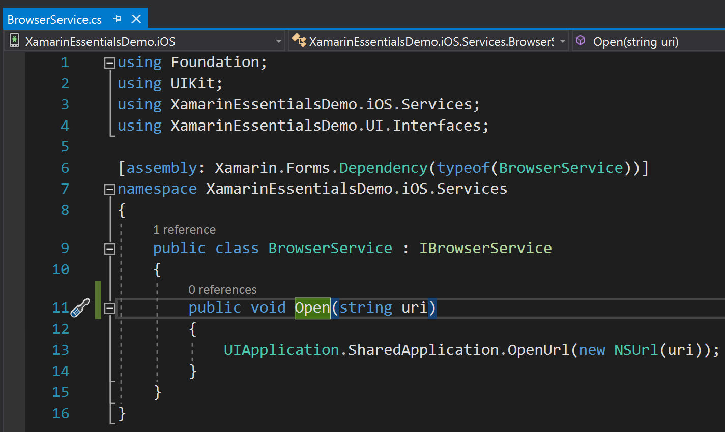
Steps To Building Cross-Platform APIs With Dependency Service: Implement Interface On Platforms
Notes:
Inside of each of your platform specific projects, implement the interface defined in your shared code. Once you have implemented your interface, you will need to map the dependency so that it can be resolved by the dependency service.

Slide 27
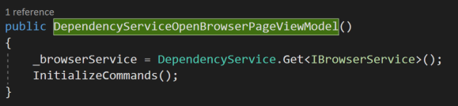
Steps To Building Cross-Platform APIs With Dependency Service: Resolve Interface Using Dependency Service
Notes:
Finally, In your shared code, you will be able to access the cross-platform API by resolving the dependency using the DependencyService. This will resolve the dependency with the platform specific implementation of your interface.

Slide 28
Xamarin.Essentials
Notes:
Ok, now that we know where to learn about Xamarin Forms, let’s learn how to get started with our project.

Slide 29
Add Xamarin Essentials Nuget Package
Accelerometer
App Information
Barometer
Battery
Clipboard
Compass
Connectivity
Data Transfer
Device Display Information
Magnetometer
Main Thread
Map
Open Browser
Orientation Sensor
Phone Dialer
Power
Preferences
Screen Lock
Secure Storage
SMS
Text-to-Speech
Version Tracking
Vibrate
Troubleshooting
Device Information
Email
File System Helpers
Flashlight
Geocoding
Geolocation
Gyroscope
Launcher
Notes:
With Xamarin.Essentials there are quite a few useful APIs made available. These include common inqueries such as app information, connectivity, geolocation, etc. This Nuget package includes 32 cross-platform APIs, and as development continues, there will likely be more in the future.

Slide 30
Xamrin Essentials Benefits
Access to common dependencies without manual resolutions
Supported by Microsoft
Less testing effort
Less application maintenance
Less reliance on 3rd party Nuget packages
Notes:
There are plenty of reasons why Xamarin Essentials is important to utilize when developing mobile applications with the Xamarin tool kit. First, Xamarin allows us to access common dependencies without implementing dependency resolutions ourselves. Second, the Nuget package is developed and maintained by Microsoft, so the quality of the code is reliable. Additionally, since we are not developing the implementation ourselves and it comes from a reliable author, there is less of a testing effort that our teams are responsible for. To go along with the previous, there is less maintenance since any updates to iOS and Android that would break the dependency resolution will be provided in Nuget updates. Finally, we can ditch some of the less reliable 3rd party nuget packages and get a combine solution in Xamarin.Essentials.

Slide 31
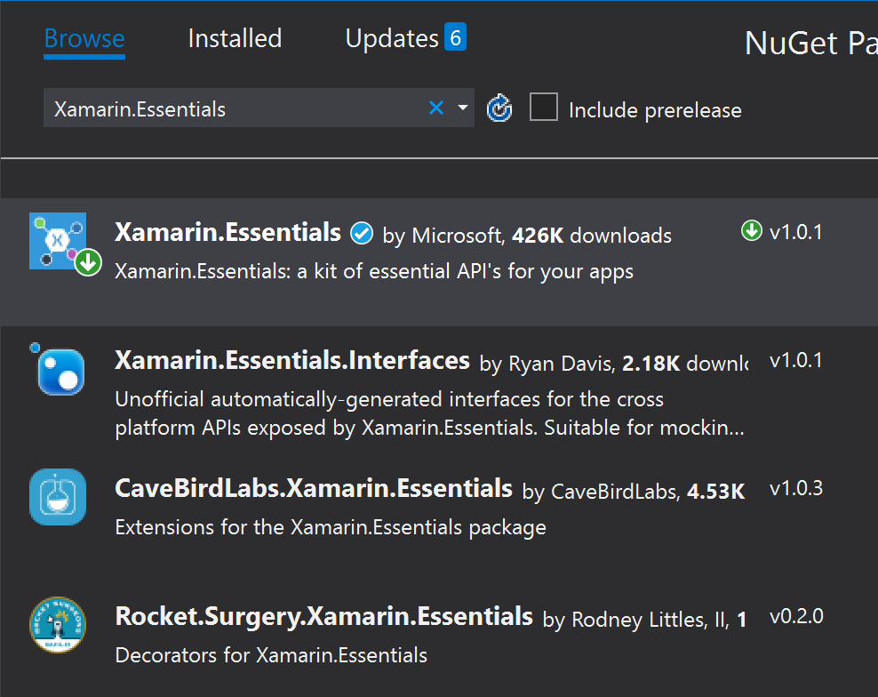
Add Xamarin Essentials Nuget Package
Notes:
Now, to get started using Xamarin Essentials, the first thing you will need to do is add the Nuget package to all of your projects. You can do this by right clicking on the dependencies of your project and selecting “Manage Nuget Packages.” This will take you to the NuGet Package Manager. Once here, search for “Xamarin.Essentials” and install. This same process will have to be repeated for all of your shared/platform specific projects.

Slide 32
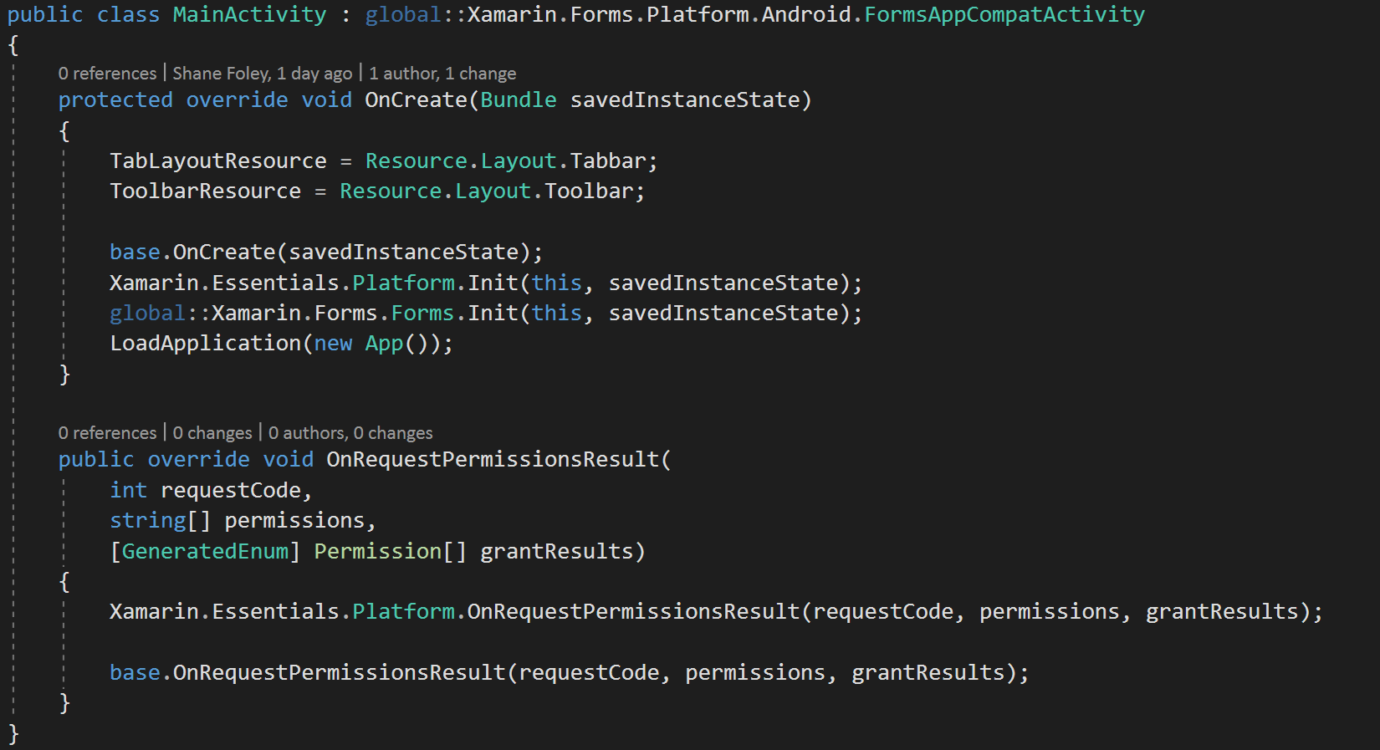
Initialize Android Xamarin.Essentials
Notes:
For Android, to make sure that Xamarin.Essentials is ready for use, we will initialize it in our main activity OnCreate function. Additionally, for Xamarin.Essentials to gather the necessary permissions, with will need to override our OnRequestPermissionsResult method.

Slide 33


Views And View Models
Notes:
Now that we have some of the base dependencies out of the way, lets talk about views and view models. It is extremely common to see UI development split UI responsibility between the view and the view model.

Slide 34
The View Model
Exposes data for the UI to display
Responsible for handling UI input
Exposes commands that can be bound
Overall, creates a “model” of what is shown to user
Notes:
First consider the view model. The view model is responsible for exposing data for the UI to display. The view model coordinates UI interaction through commands and two-way bound values. Over all, the view model is what it sounds like, it is a model for what the user is able to see on a page.

Slide 35
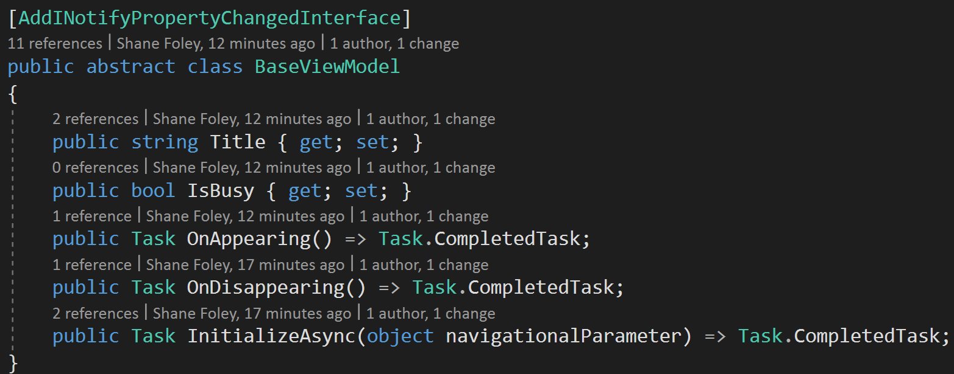
Base View Model
Notes:
Consider a base view model. Some of the common things that you will to model it the title of the page, busy indications and messages, and what happens when the page appears/disappears. Additionally, we need to be able to initialize our view models based on information passed from other pages. Finally, notice that we have an AddINotifyPropertyChangedInterface decorator. We will talk about this in a couple of slides.

Slide 36
The VieW
Utilizes the view model to display information to the user
Often utilizes
Behaviors
Example: Phone number masking
Converters
Example: Converting priority to a color
Notes:
Next, we have the view. The view takes the information from the view model to display a user interface. The view is generally mostly composed of a XAML partial class with values bound the view model, behaviors, converters, images, etc.

Slide 37
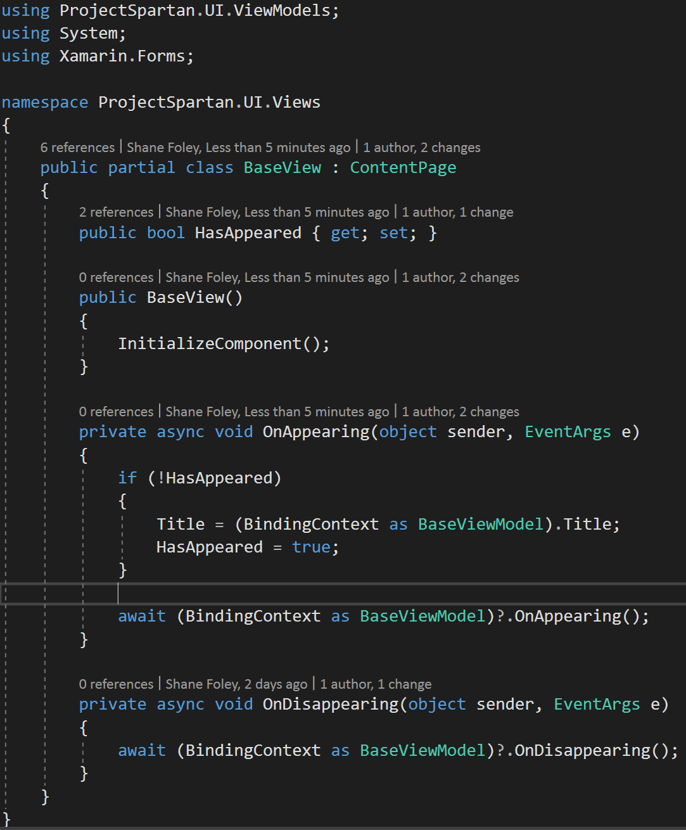
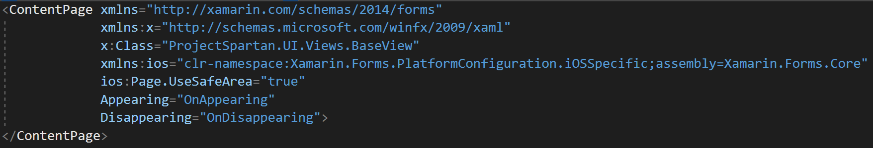
Base View
Notes:
In the BaseView cs partial class, we have a property to track if the view has already appeared before. This allows us to set the title of the page exactly once. Additionally, we have overrides for OnAppearing and OnDisappearing so that we can trigger the view models equivalents. Now for the XAML portion. The Appearing and Disappearing is bound the methods in the code behind. Additionally, we set up the pages throughout the application to be iPhone notch friendly. We do this by setting the iOS “safe area” to true. This makes it so your UI does not overlap with the notch.

Slide 38
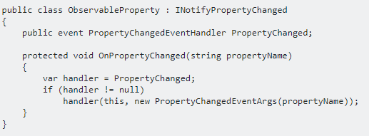
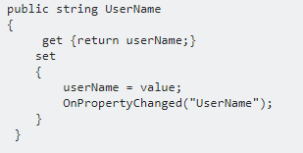
UI Updates In Xamarin
To display data to the user, we generally use bindings
If the ViewModel updates, we want our view to update
INotifyPropertyChanged
Every Property calls OnPropertyChanged in setter
Notes:
Now, lets look into what has to happen for our UI to update when the view model updates. Generally, the view uses bindings from the view model. To trigger updates to bound values, the binding source needs to implement INotifyPropertyChanges. As seen in the presented slide, this can be extremely tedious. To mitigate the changes, we could produce an ObservableProperty class to use as a base and call OnPropertyChanged in every property setter in the view model. This is obviously still time consuming and not ideal for long term application development. Good news, we don’t have to do this.

Slide 39
Fody
Manipulates the intermediate language of an assembly as part of a build
Implements INotifyPropertyChanged and all plumbing for properties
https://github.com/Fody/Fody
Notes:
Instead of implementing INotifyPropertyChanged, we can instead utilize the Fody weaver. Upon building our applications, fody manipulates the intermediate language of the assembly. During the manipulation of the intermediate language, Fody “weaves” in the plumbing for INotifyPropertyChanged. To have this happen, all you’ll have to do is decorate the view models with the AddINotifyPropertyChangedInterface attribute. For our project, we did this in the BaseViewModel, so this is taken care of for all our children view models.

Slide 40
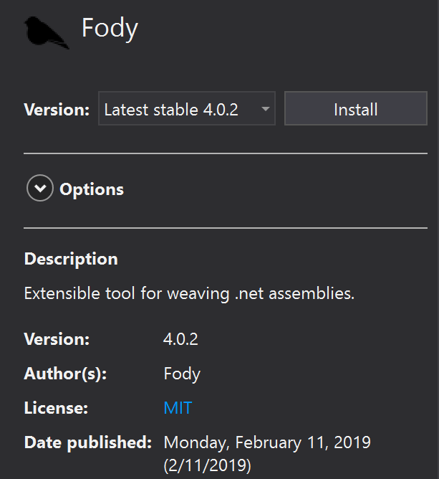
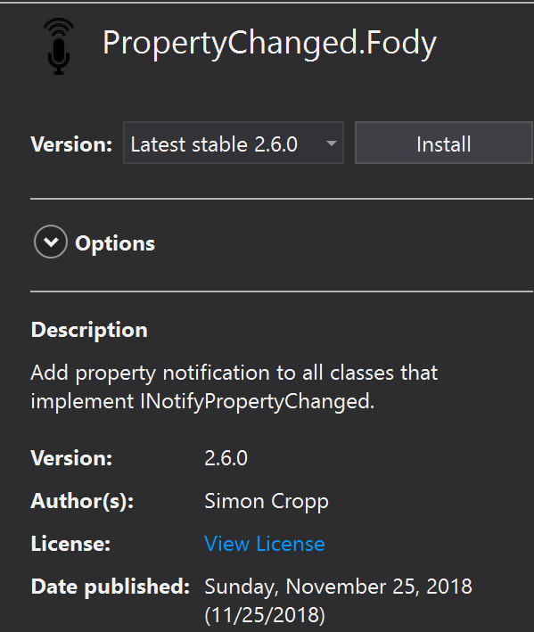
Add Fody + PropertyChanged.Fody
Notes:
There is some process that goes into getting Fody set up, so we will go into that now. First, you with go to the nuget package manager and search for Fody. Once Fody is located, install the latest stable version. Additionally, we need to install PropertyChanged.Fody. This is the nuget package that provides us with the AddINotifyPropertyChangedInterface attribute and the ability for Fody to weave INotifyPropertyChanged implementations.

Slide 41
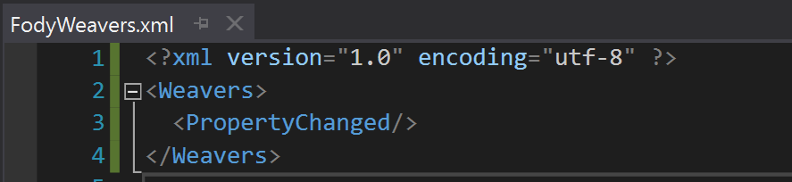
Add Fody + PropertyChanged.Fody
FodyWeavers.xml
Notes:
Additionally, we will have to add the FodyWeavers.xml file to our solution. This will include the Weavers block containing a PropertyChanged tag. Once that is added to your project, you are ready to start adding your AddINotifyPropertyChangedInterface attribute.

Slide 42
Resolving Dependencies
Notes:
When developing mobile applications, it is important to consider how your application will resolve dependencies. In the next couple of slides, we will discuss a recommended technique.

Slide 43
Inversion Of Control
Object coupling is bound at runtime by an assembler
We are no longer responsible for specifically instantiating objects that fulfill a contract, the framework is
Notes:
When resolving dependencies, you will want to take advantage of a pattern known as inversion of control. With inversion of control, we are not responsible for specifically instantiating objects that fulfill a contract. Instead, the framework is responsible for resolving the contract. This object coupling is bound at runtime by the assembler.

Slide 44
Dependency Injection
Technique to resolve dependencies of a consuming object
“A dependency is an object that can be used (a service). An injection is the passing of a dependency to a dependent object (a client) that would use it. ” - Wiki
Notes:
Dependency injection is a pattern that utilizes inversion of control. In dependency injection, we add contracts of dependencies in our constructors. We then rely on inversion of control to resolve the dependency. We do not care for the specific class that resolves, as that is implementation details beyond what a client needs to know.
https://en.wikipedia.org/wiki/Dependency_injection

Slide 45






IoC Containers
An IoC Container is a framework that handles IoC in our applications
Many options
Autofac
MvvmCross
Ninject
TinyIoC
Unity
Simple Injector
…
Notes:
Now, since we know a bit about inversion of control, we need to select an IoC container, which is a specific framework we utilize to handle inversion of control. There is no shortage of choices, including the following: Autofac, MvvmCross, Ninject, TinyIoC, Unity, and Simple Injector. All of these frameworks have a similar feature set with minute differences, so all are viable options.

Slide 46
Simple Injector
Notes:
For our sample application, simple injector was selected purely for familiarity. Again, all of the prior frameworks have a similar feature set, so use what you are comfortable with.

Slide 47
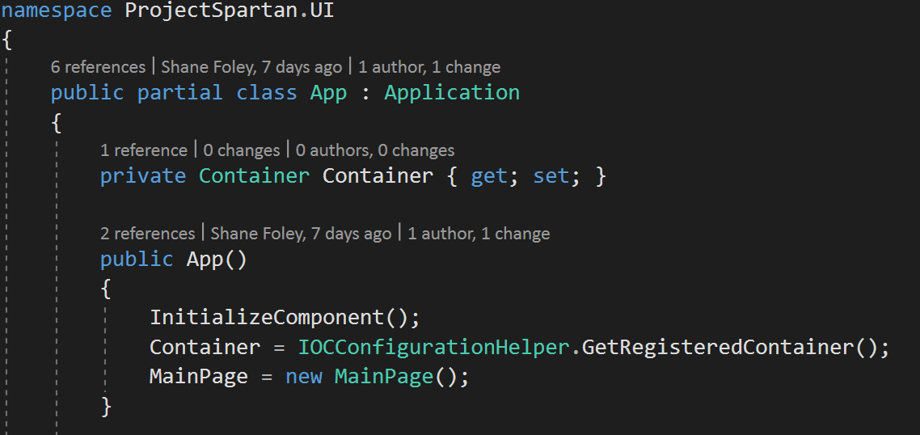
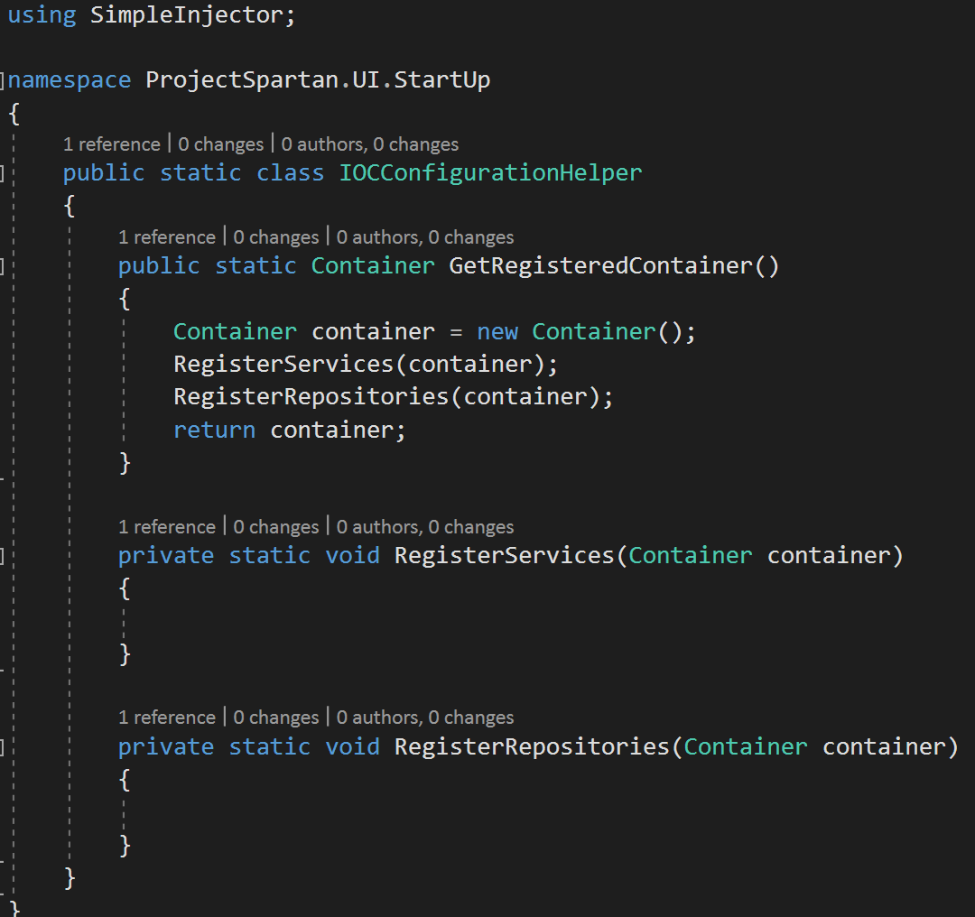
Simple Injector
Notes:
To utilize simple injector, we create a Container property at the root of our application. In the instance of a Xamarin Forms application, this is the App code behind in our App.xaml.cs file. In the constructor of the App class, we set an instance of our container object. In this case, I created an IOCConfigurationHelper class to help with the setup of the container, as this will grow over time, and we do not want to clutter the starting point of our application. In our IOCConfigurationHelper class, we have a static method to get a registered container, which then in turn registers our services, and our repositories. As you can see, the IOCConfigurationHelper is a class ready to grow as our application grows.

Slide 48
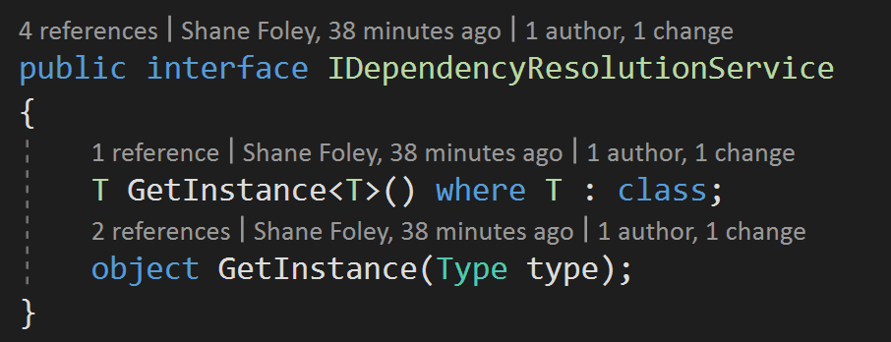
Dependency Resolution Service
Notes:
While on the topic of resolving dependency, it is useful for your application to have a DependencyResolutionService so that you can resolve ad-hoc dependencies. A perfect example of why this is needed is navigation as we will see in the following slides.

Slide 49
Navigation
Many different approaches
Using variant of Microsoft’s Enterprise App Navigation
https://docs.microsoft.com/en-us/xamarin/xamarin-forms/enterprise-application-patterns/navigation#related-links

Slide 50
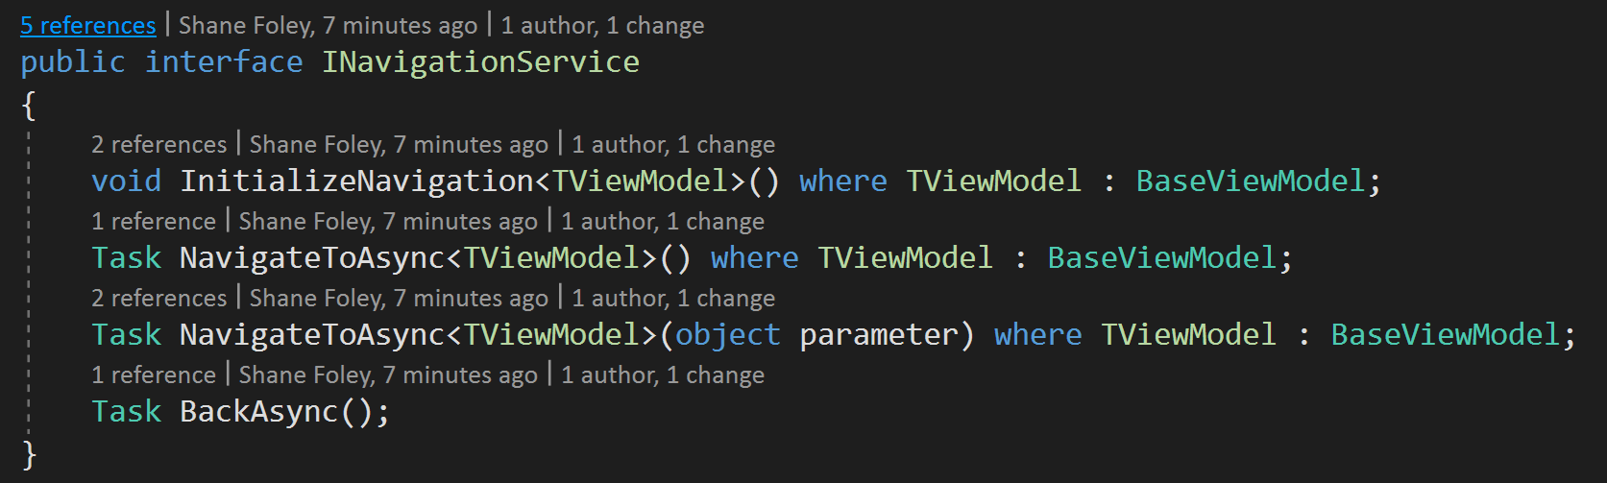
Navigation
Notes:
First, we will define the navigation contract that we want fulfilled. We want to be able to InitializeNavigate when our application starts up. We want to be able to navigate to other pages, and we want the ability to pass a parameter to another page. Finally, we want to be able to navigate backwards in our application.

Slide 51
Other Starting Procedures
Configuration setup
Development, test, validation, staging, production
Base API service
GET, POST, PUT, DELETE
Unit testing framework
Moq, NSubstitute, MSTest, Nunit, etc

Slide 52

Closing Thoughts
Positioning mobile applications for long term development requires commitment to organization
Shortcuts will come back to bite you as tech debt
Refactoring
Rewrites
Tech debt
Time
Money

